Slide 1
Machine Learning Study week 4
Hands – on Machine Learning
with Scikit-Learn & TensorFlow

Slide 2
Chapter 1. The Machine Learning Landscape
이 단원에서 주로 다루고 있는 내용은 1, 2, 3 주차에 충분히 다뤘다고 생각하여 생략.

Slide 3
Chapter 2. End-to-End Machine Learning Project
이 단원에서는 우리가 data scientist가 되어 한 프로그램을 처음부터 끝까지 다뤄본다.
우리가 있는 field는 real estate company이다.

Slide 4
Chapter 2. End-to-End Machine Learning Project
우리가 할 steps은 아래와 같다.
1. Look at the big picture.
2. Get the data.
3. Discover and visualize the data to gain insights.
4. Prepare the data for Machine Learning algorithms.
5. Select a model and train it.
6.Fine-tune our model.
7.Present our solution.
8.Launch, monitor, and maintain our system.

Slide 5
Section 0.0. Working with Real Data
우리가 data를 얻을 수 있는 sources.
Popular open data repositories:
UC Irivne Machine Learning Repository
Kaggle datasets
Amazon’s AWS datasets
Meta portals (they list open data repositories):
http://dataportals.org/
http://opendatamonitor.eu/
http://quadl.com/

Slide 6
Section 0.0. Working with Real Data
우리가 data를 얻을 수 있는 sources.
Other pages listing many popular open data repositories:
Wikipedia’s list of Machine Learning datasets
Quora.com question
Datasets subreddit
이 단원에서는 California Housing Prices dataset form the Statlib repository 를 다룰 예정이다.

Slide 7
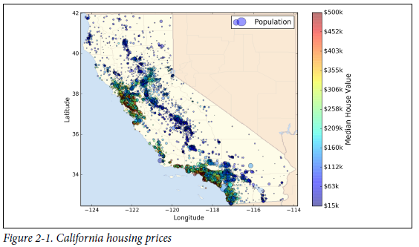
Section 0.0. Working with Real Data

Slide 8
Section 1.0. Look at the Big Picture
Main task: to build a model of housing prices in California using the California census data.
The model should be able to predict the median housing price in any district, given all the other metrics.
In this book, metrics are comprised of the population, median income, median housing price, and so on.

Slide 9
Section 1.1. Frame the Problem
Our objective: our model’s output(a prediction of a district’s median housing price) will be fed to another Machine Learning system.
This downstream system will determine whether it is worth investing in a given area or not.
Our objective will determine how we frame the problem, what algorithms we will select, what performance measure we will use to evaluate our model, and how much effort we should spend tweaking it.

Slide 10
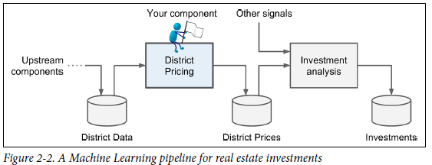
Section 1.1. Frame the Problem

Slide 11
Section 1.1. Frame the Problem
Also, we should know what the current solution looks like.
This is because, it will often give you a reference performance, as well as insights on how to solve the problem.
Suppose that in the past, experts had not used helpful methods.

Slide 12
Section 1.1. Frame the Problem
Question.
Is it supervised, unsupervised, or Reinforcement Learning?
Is it a classification task, a regression task, or something else?
Should we use batch learning or online learning techniques?

Slide 13
Section 1.1. Frame the Problem
Question.
Is it supervised, unsupervised, or Reinforcement Learning?
- Hint: we have labeled training examples.
Is it a classification task, a regression task, or something else?
- Hint: we want to make a model to predict a value.
Should we use batch learning or online learning techniques?
- Hint: there is no continuous flow of data coming in the system, there is no particular need to adjust to changing data rapidly, and the data is small enough to fit in memory.

Slide 14

Section 1.2. Select a Performance Measure
A typical performance measure of regression problems is the Root Mean Square Error (RMSE). It measures the standard deviation of the errors the system makes in tis predictions.
$RMSE\left(X,h\right)={\left(\frac{1}{m}\sum_{i=1}^{m}{{\left(h\left(x^{\left(i\right)}\right)−y^{\left(i\right)}\right)}^{2}} \right)}^{\frac{1}{2}}$
where m is the number of instances in the dataset we are measuring the RMSE on, $x^{(i)}$ is a vector of all the feature values (excluding the label) of the $i^{th}$ instance in the dataset, and $y^{(i)}$ is its label (the desired output value for that instance), and $X$ is a matrix containing all the feature values (excluding labels) of all instances in the dataset.

Slide 15
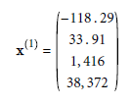

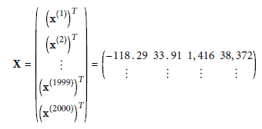

Section 1.2. Select a Performance Measure
Ex)
There is one row per instance and the $i^{th}$ row is equal to the transpose of $x^{(i)}$, noted ${\left(x^{i}\right)}^{T}$

Slide 16

Section 1.2. Select a Performance Measure
$h$ is our system’s prediction function, also called a hypothesis. When our system is given an instance’s feature vector $x^{(t)}$, it outputs a predicted value ${\hat{y}}^{t}=h(x^{t})$ for that instance.

Slide 17



Section 1.2. Select a Performance Measure
Other performance measure.
Mean Absolute Error
$l_{k}$ norm and so on.
The higher the norm index, the more it focuses on large values and neglects small ones. This is why the RMSE is more sensitive to outliers than the MAE.
But when outliers are exponentially rare (like in a bell-shaped curve), the RMSE performs very well and is generally preferred.

Slide 18
Section 1.3. Check the Assumptions
Lastly, it is good practice to list and verify the assumptions that were made so far; this can catch serious issues early on.

